Slide 1
Parking Spots Allocation
Presentation and Detailed Report
Francisco Teixeira Lopes up201106912
Maria Eduarda Santos Cunha up201506524

Slide 2
Problem Description
This project concerns the allocation of parking lots to several cars. The cars have certain requirements regarding the kind of spot they prefer and negotiate with the various parking lots to assess which is the best one for them.
Decision variables:
cost hourly cost of parking in a specific parking lot / spot type combo
distance to parking lot measured between the parking lot and the current position of the car agent
spot type regular, luxury and handicap

Slide 3
Global Scheme
Car Agent
CarAgentProposal::CarEvaluator
-eval
~agent
StrictCarEvaluator
LowerCostCarEvaluator
~agent
~proposal
CarBehavior
ParkingLotProposal
LowerDistanceCarEvaluator
FlexibleCarEvaluator

Slide 4
ParkingLotAgent
ParkingLotBehavior
CarAgentProposal
Logger
~agent
-agent
ParkingLotTimer
~desiredSpots
-logMethod
SpotType
LogMethod
RandomConfigParser
RunAgents
FixedConfigParser

Slide 5
Protocols and Interaction
Initiator
Participant
cfp
m
We based our protocol on FIPA Contract Net Interaction Protocol.
The main difference between our implementation and the original is we do not have the failure and inform-result : inform options.
Initiator Cars
Participants Parking Lots
Cfp Car Agent Proposal
i<=n
refuse
n deadline
j=n-i
propose
reject-proposal
k<=j
accept-proposal
l=j-k
failure
inform-done : inform
inform-result : inform

Slide 6
Initiator
Participant
1
Car issues a call for proposals which asks for m proposals from other Parking Lots and includes desired cost, distance and spot type.
Parking Lots receiving the call for proposals, considered potential contractors, generate n responses. Of these, j are proposals to perform the task, if they have at least one of the expect spot types, and i=n-j are refusals, if they do not have a single expected spot type.
After the deadline (10 seconds), the Car evaluates received j proposals and selects one Parking Lot to perform the task. The l Parking Lot of selected proposals are sent an accept-proposal act and the remaining k Parking Lots receive a reject-proposal act.
1
cfp
m
i<=n
refuse
n deadline
2
2
j=n-i
propose
reject-proposal
k<=j
3
accept-proposal
l=j-k
3
failure
inform-done : inform
4
inform-result : inform

Slide 7
Initiator
Participant
Proposals are binding on the participant, which means, once the Car accepts the proposal, the Parking Lot must perform the task.
Once the Parking Lot has completed its task (Car is parked), it sends a completion message to the Car (inform-done : inform).
1
cfp
m
i<=n
refuse
n deadline
4
2
j=n-i
propose
reject-proposal
k<=j
3
accept-proposal
l=j-k
failure
inform-done : inform
4
inform-result : inform

Slide 8
Agents Architecture and Utilized Strategies
There is 1 class per agent and 1 class per behaviour.
There are 2 types of agents Cars and Parking Lots and a Car may have 4 different types of behaviour: Strict, Lower Cost, Lower Distance and Flexible.
best offer regarding cost and distance within certain limits
StrictCarEvaluator.java
Agents are deliberative, since they consider options within certain boundaries.
CarAgent.java
LowerCostCarEvaluator.java
best offer regarding cost
LowerDistanceCarEvaluator.java
best offer regarding distance
FlexibleCarEvaluator.java
settles within certain limits
ParkingLotAgent.java
Notes:
Estrategias -> comportamentos modulos que tem la (contract e iniator)

Slide 9
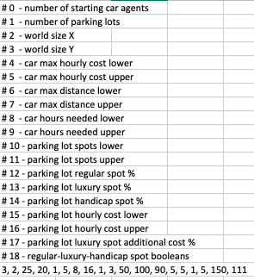
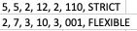
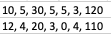
Other Mechanisms
How are our agents created?
In order to determine agents, when running the project, there are 2 possibilities considering different configuration files:
Randomize agents random.csv
Set specific agents cars.csv and lots.csv
random.csv
cars.csv
lots.csv
These configuration files essentially hold a sequence of numbers or tags that correlate to parameters of the proposals such as cost and distance bounds or type of spot, parameters relating to time a Car is allowed to spend in a Parking Lot and so on.
For easier understanding, all csv files have the meaning of each number/tag stated in the beginning.

Slide 10

What are some important controlling aspects?
Controlling aspects are set in RunAgents.java:
As agents are created, both Car and Parking Lots, we check to make sure their coordinates never overlap.
Car agents are put into a Linked Blocking Queue where they each await their turn for negotiation, i. e., their chance to become the Initiator.

Slide 11
Performed Experiments

Slide 12
Results Analysis

Slide 13
Conclusion
Used Software
JADE Java Agent Development

Slide 14
Report

Slide 15
Execution Examples
Notes:
Escalavel

Slide 16
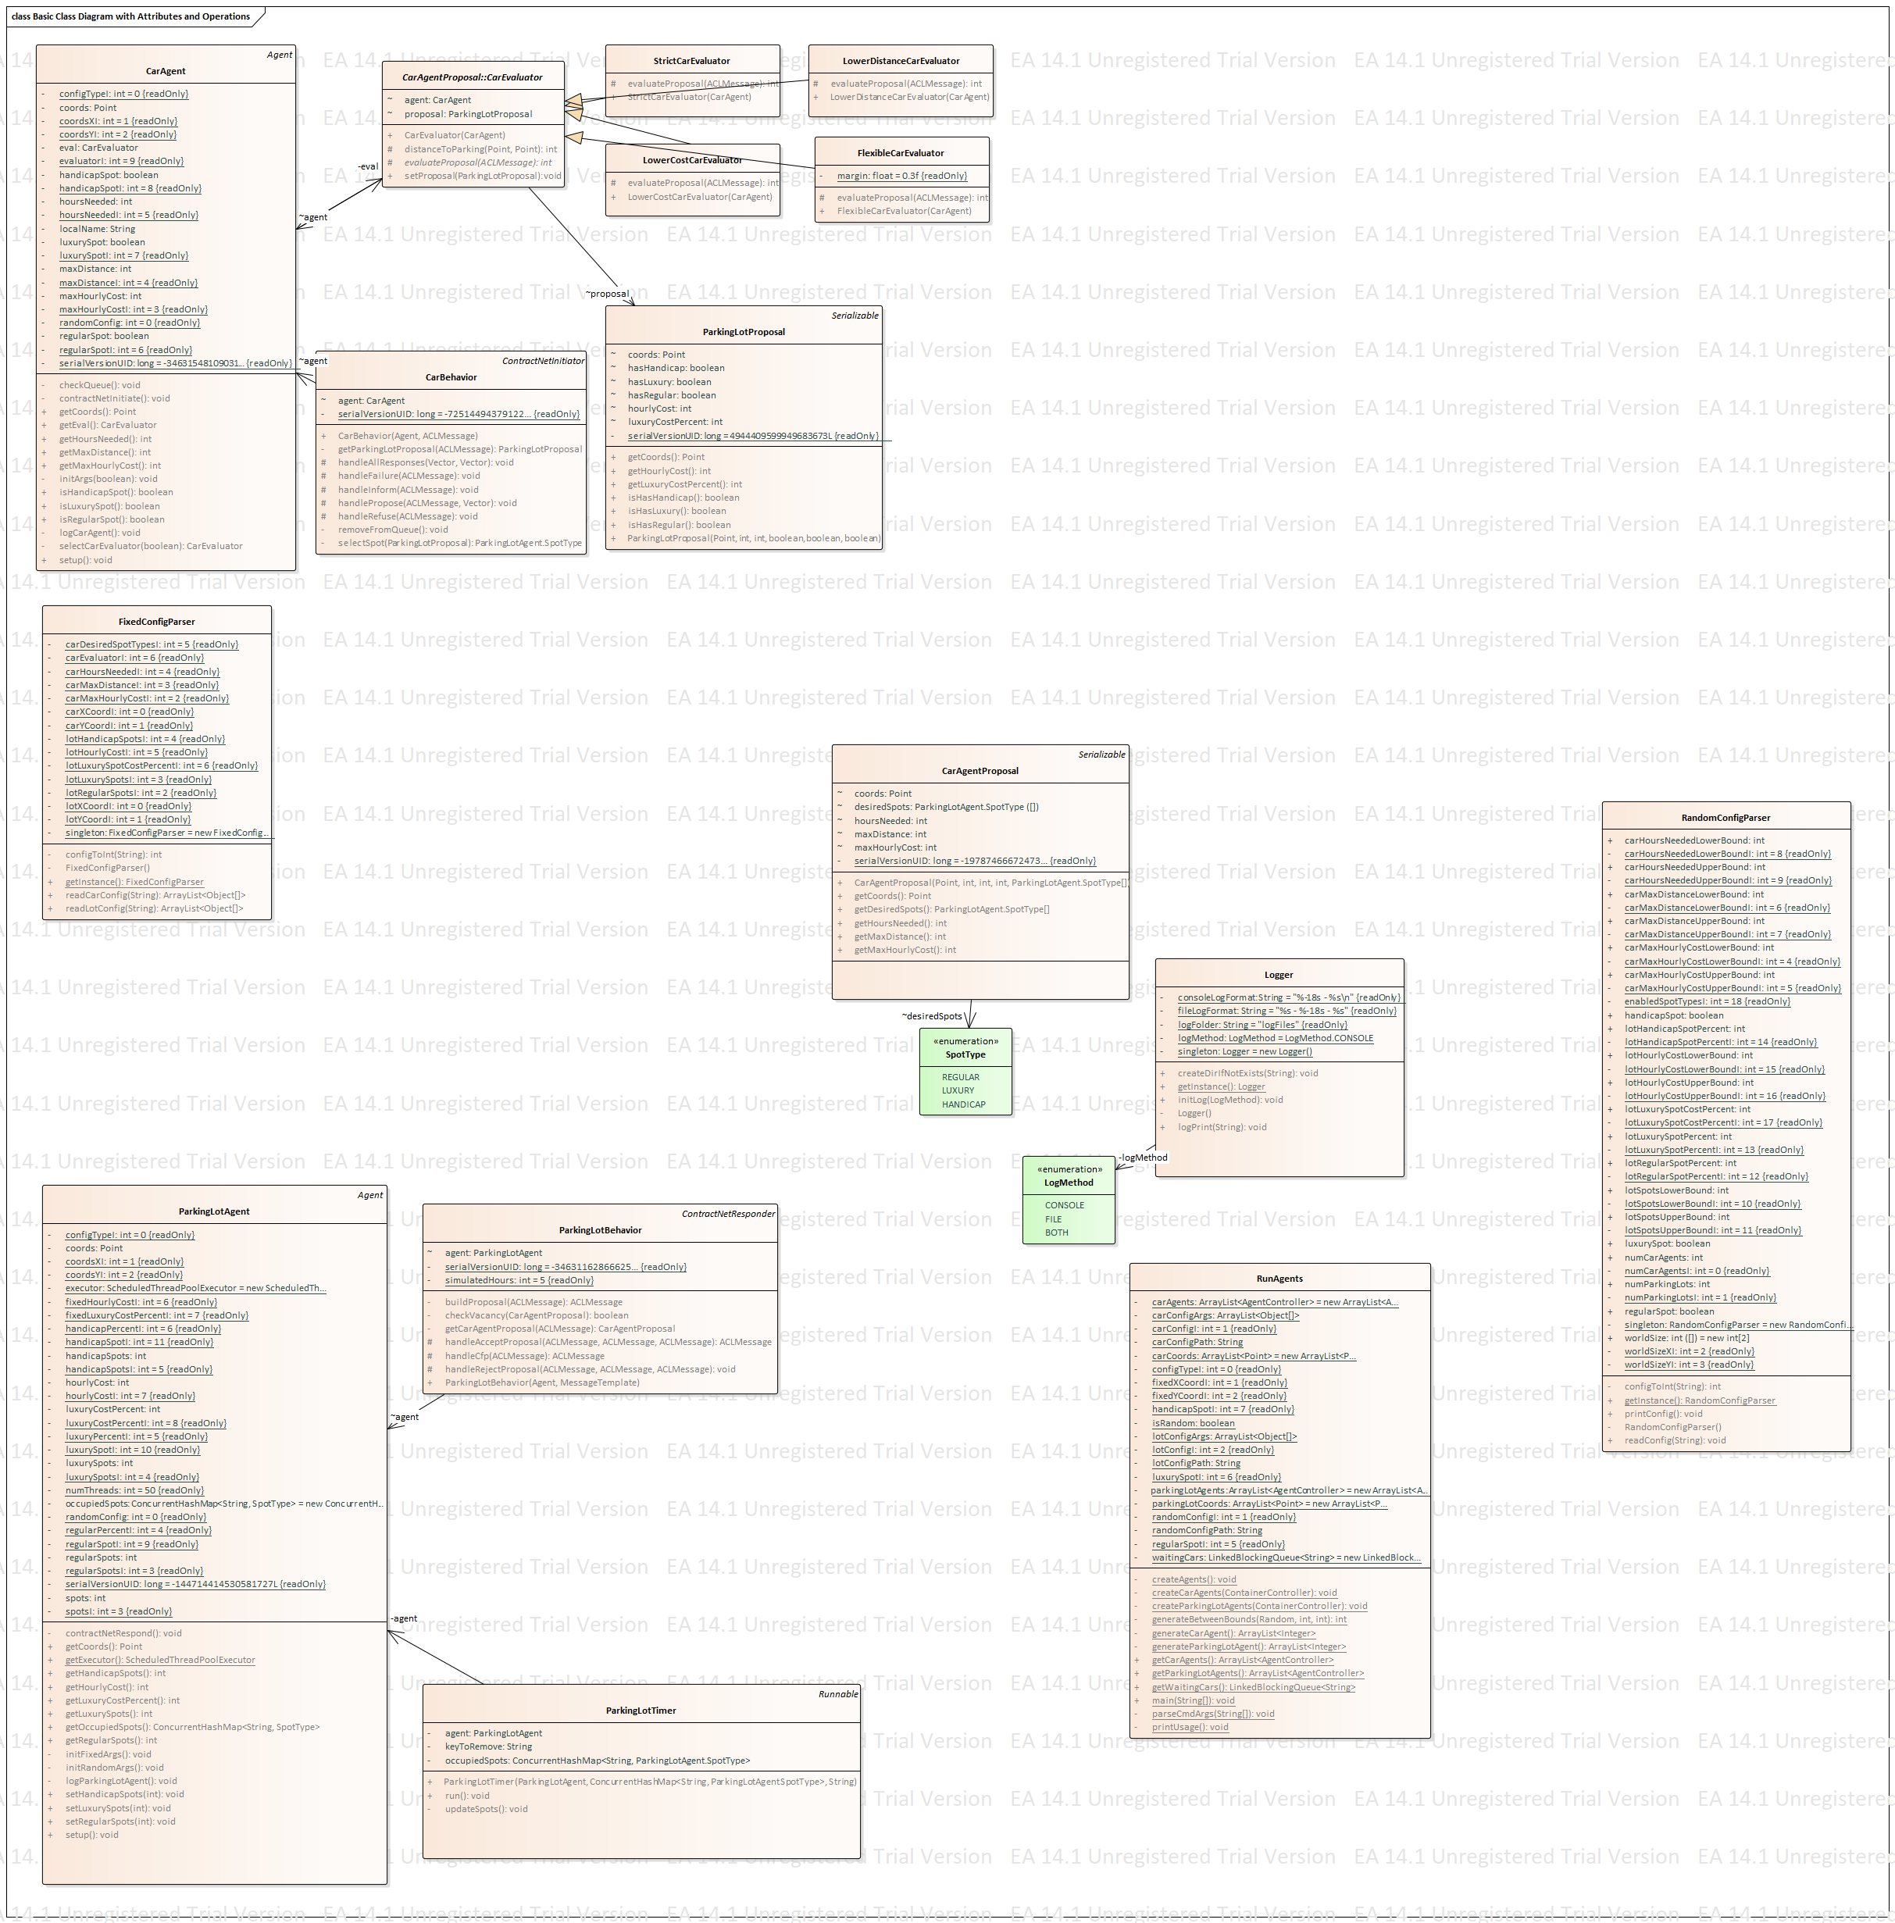
Implemented Classes
Constructors for agents Car and Parking Lot:
Essentially main class, where all methods are called and initiated:

Slide 17
Constructs a Car behaviour responsible for handling the ContractNetInitiator role in our FIPA ContractNet protocol. Sends a cfp message signalling the desired spot types to which Parking Lot agents respond with their proposals provided a spot of the desired type is available. The Car agent then evaluates the proposals and chooses to accept 0 or 1 of them.
Constructs a Parking Lot behaviour responsible for handling the ContractNetResponder role in a FIPA ContractNet protocol. Waits for a cfp messages, sends a proposal and awaits acceptance or rejection of the proposal. A proposal may not be sent if the Parking Lot has no more spots of the requested type.

Slide 18
Encapsulates all the information needed for a Car agent to send a cfp message to the Parking Lot agents.
Encapsulates all the information needed for a Parking Lot agent to send a proposal message to a Car agent.
This set of classes are responsible for constructing Car evaluator objects responsible for assigning a value to Parking Lot proposals. According to the class different parameters are taken into account.

Slide 19
Constructs a Parking Lot timer responsible for vacating a spot when the scheduled time has elapsed. Vacating a spot means updating the number of spots available on the Parking Lot used to construct the timer.
Information taken from configuration files is parsed and returned as a list of object arrays which can be later used to generate agents with those attributes.

Slide 20
Other Observations

